Slide 1
AL_cringe Team
A creative and innovative engineering team with strong passion for robotics.
This team has 5 years of experience in the field of robotics.
They have achieved several honorable places in various international competitions.
The team was founded on September 12, 2022, with the goal of participating in both national and international competitions, as well as introducing new types of robotics contests and innovations to Uzbekistan..

Slide 2
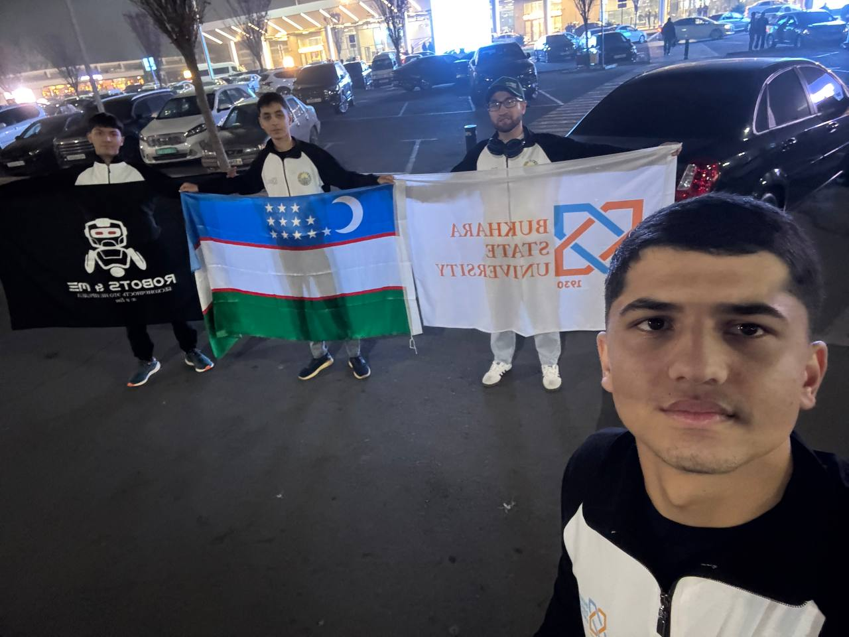
Team Members
Three talented members + one experienced coach.

Slide 3
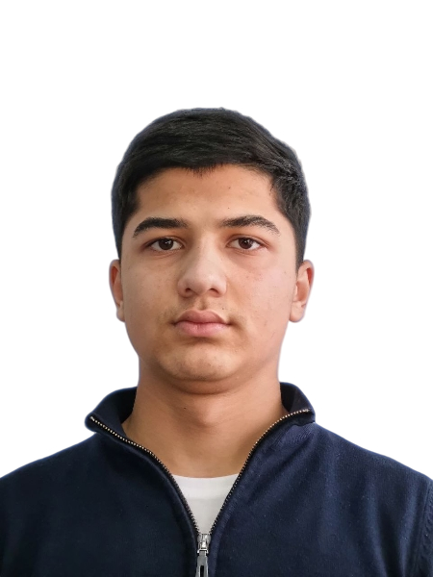
Nazarov Asadbek Engineer
Team engineer. Responsible, detail-oriented, skilled in designing reliable technical solutions.
He is also generates innovative ideas for creating new robot constructions and various electronic circuit designs.

Slide 4
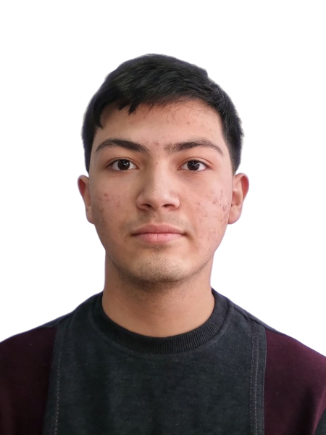
Narziyev Akbarshox Coder
Team coder. Strong in programming, algorithmic thinking, and clean code structure.
He is also responsible for overall team management.

Slide 5
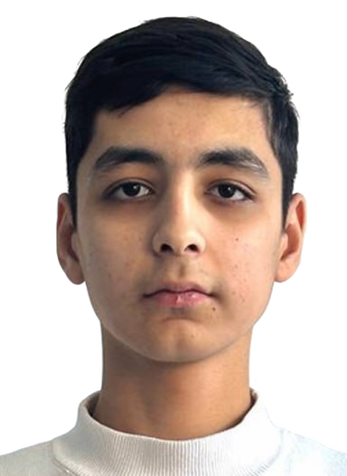
Khafizof Shoxruxmirzo Cadder
Team - Cad Designer “Shoxruxmirzo is the team’s dedicated CAD designer who specializes in creating precise 2D and 3D models for all mechanical parts of the robot.
He ensures that every component fits perfectly, maintains structural stability, and follows engineering standards.

Slide 6

Our Coach “Ergashev Navruz “
A long-time robotics professor.
Founder of Robots&Me Education Center.
Our mentor for 6 years — a truly inspiring teacher.
Our coach supports us financially and helps us solve any problems we face during robot construction. We deeply respect him and appreciate everything he does for us.

Slide 7
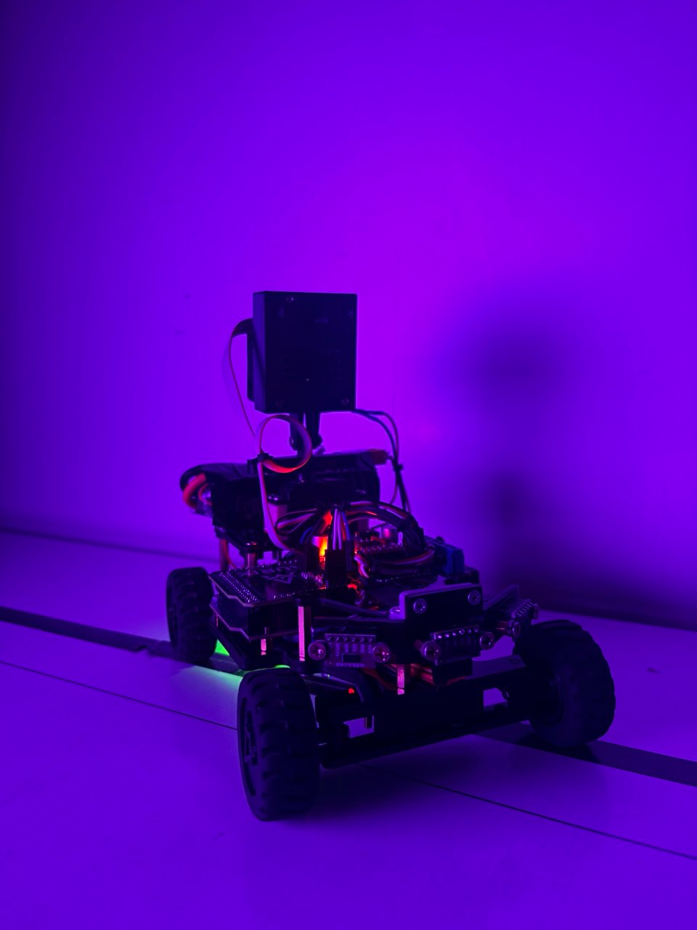
Robot Name – AURIX
AURIX is designed for WRO 2025 Future Engineer category.
Our robot has a very serious, professional appearance.
It is extremely fast, highly functional, and built for stable performance in competitions.

Slide 8
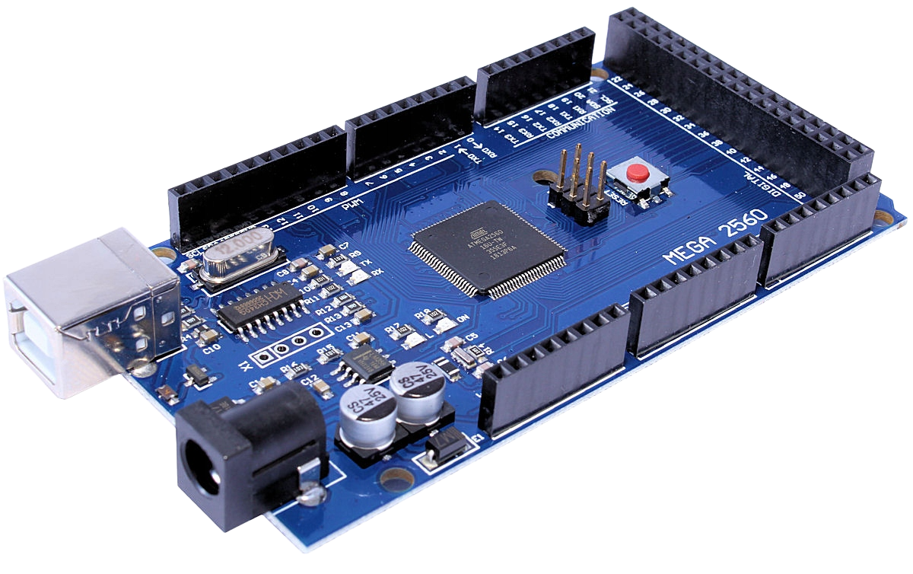
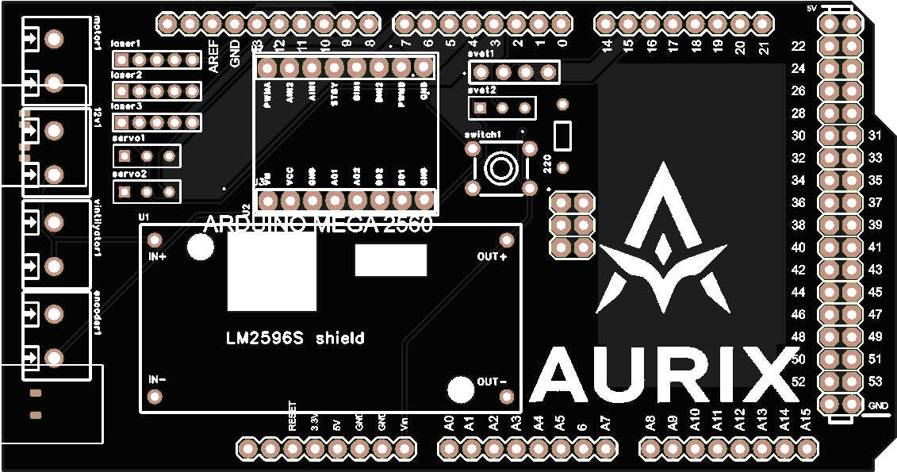
Main Electronics
Main board: Arduino Mega 2560.
Custom-designed PCB shield created by our team.

Slide 9
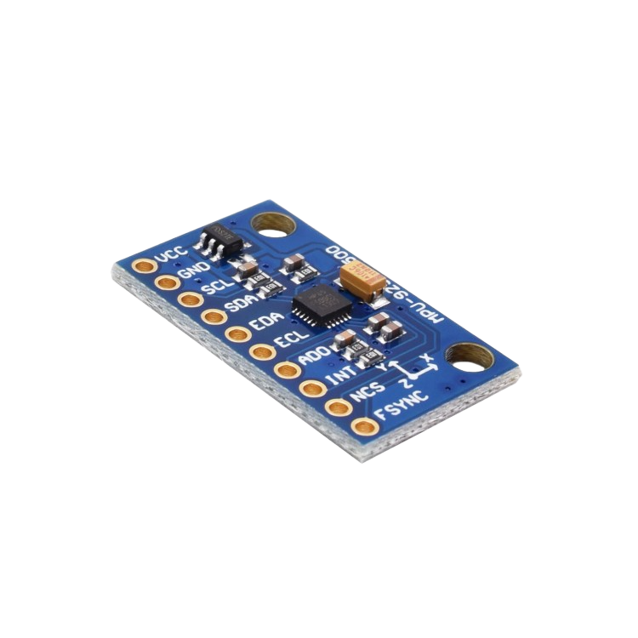
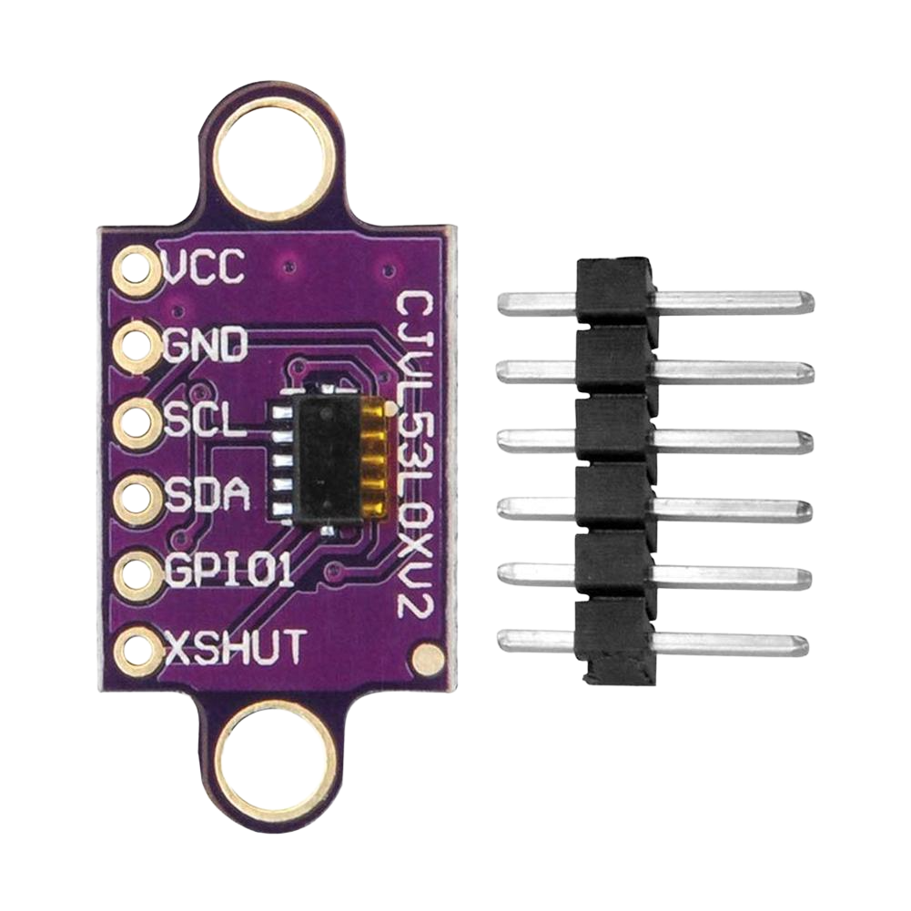
Sensors
The VL53L0X is a compact time-of-flight laser sensor that measures distance with high accuracy. It provides fast readings, works well in various lighting conditions, and is ideal for obstacle detection and precise robot navigation.
The MPU6500 gyroscope is used to measure the robot’s rotation and orientation. It helps the robot keep its direction stable, make accurate turns, and prevent drifting during movement. This ensures smoother navigation and more precise control in the maze or on the track.

Slide 10
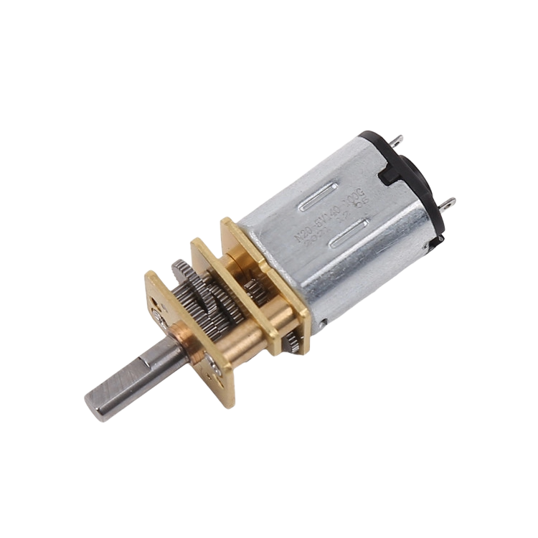
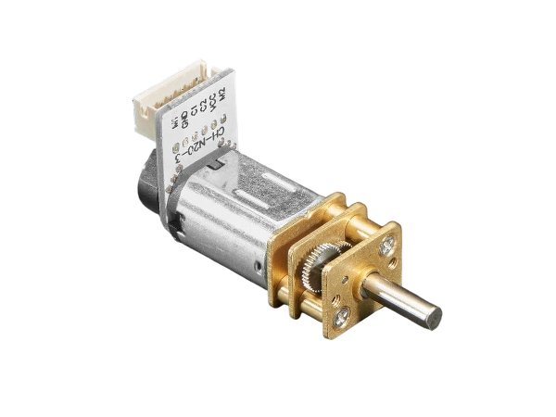
Drive System
We have two N20 800 RPM motors installed with gear ratio;1.2, and this allows the robot to move steadily and maintain stable motion, regardless of its weight
And an additional N20 encoder motor is installed, which helps the robot move more accurately over a given distance and ensures precise turning during rotations.

Slide 11
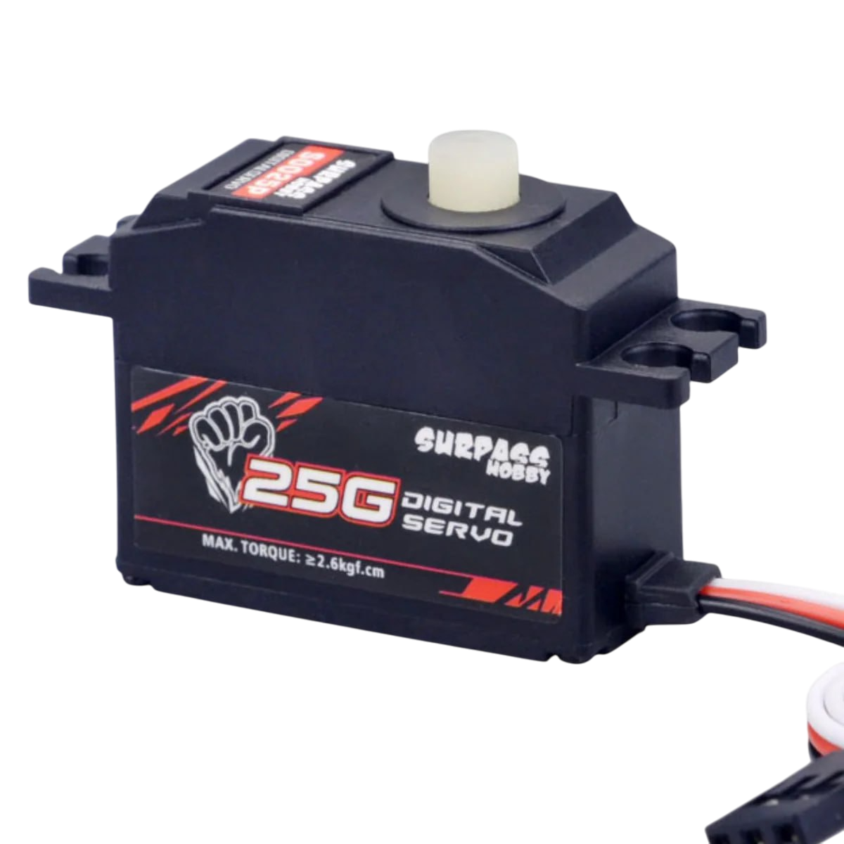
Steering System
25 g digital servo used for precise steering control.
And a servo is also installed to move the camera to the right and left.
Key Features:
High precision: Digital circuitry provides more accurate positioning compared to analog servos.
Fast response: Reacts quickly to control signals, improving robot performance.
Torque: Typically delivers strong torque for its size, suitable for steering, lifting, and camera rotation.
Lightweight (25 grams): Ideal for small to medium robots and mechanisms.
Durable gears: Often equipped with metal gears for long-lasting performance.
Wide operating voltage: Works with common RC power supplies (4.8V–6.8V depending on model).

Slide 12
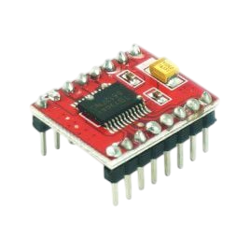
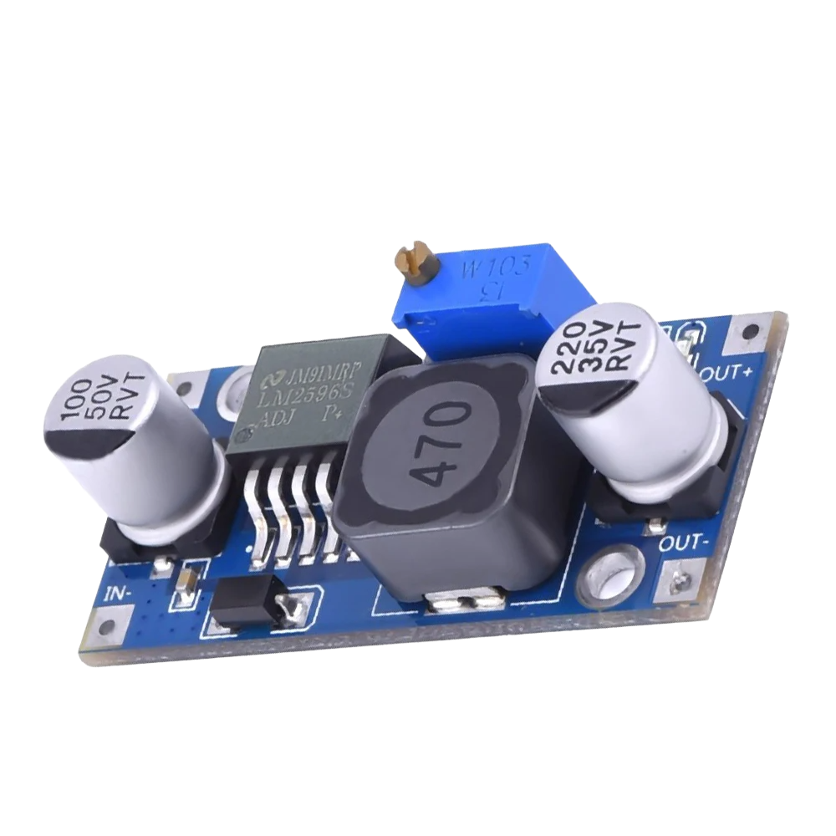
Drivers & Power System
Motor driver: TB6612FG.
Key Features:
Can drive two DC motors
Voltage range: 2.5V – 13.5V
Output current: up to 1.2A continuous, 3.2A peak
Supports PWM speed control
Provides forward, reverse, brake, and standby modes
Efficient and low heat generation
Voltage stabilizer: LM2596.
Key Features:
Input voltage: 4V – 40V
Output voltage: 1.25V – 35V (adjustable)
Output current: up to 3A
High efficiency: around 80–90%

Slide 13
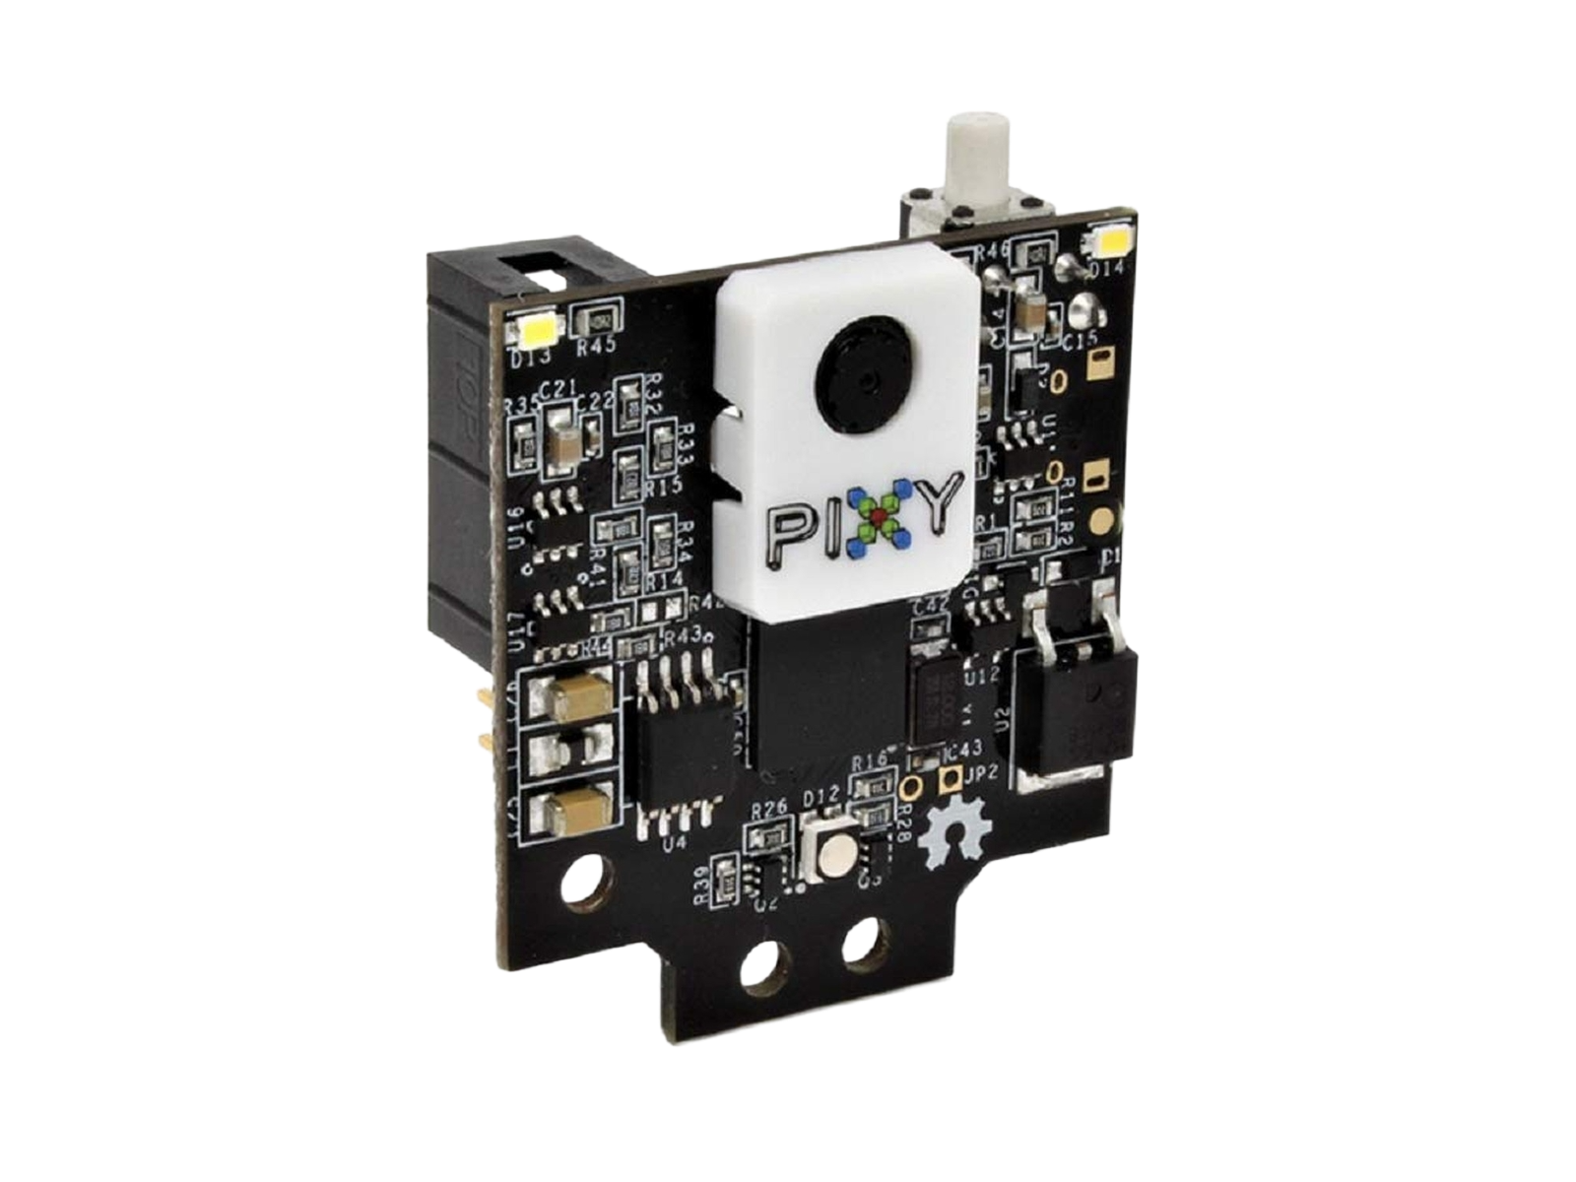
Main sensor
PixyCam 2 Functions and Features:
Color Recognition: Detects and tracks objects based on color signatures.
Object Recognition: Can recognize and follow predefined shapes or objects.
Line Tracking: Able to detect and follow lines, useful for line-following robots.
Fast Processing: Processes images onboard, allowing real-time tracking without burdening the main controller.
Multiple Interfaces: Communicates with microcontrollers via SPI, I2C, UART, or USB.
Flexible Programming: Can be trained to recognize new objects or colors easily.
Low Latency: Provides quick response for fast-moving robots.

Slide 14
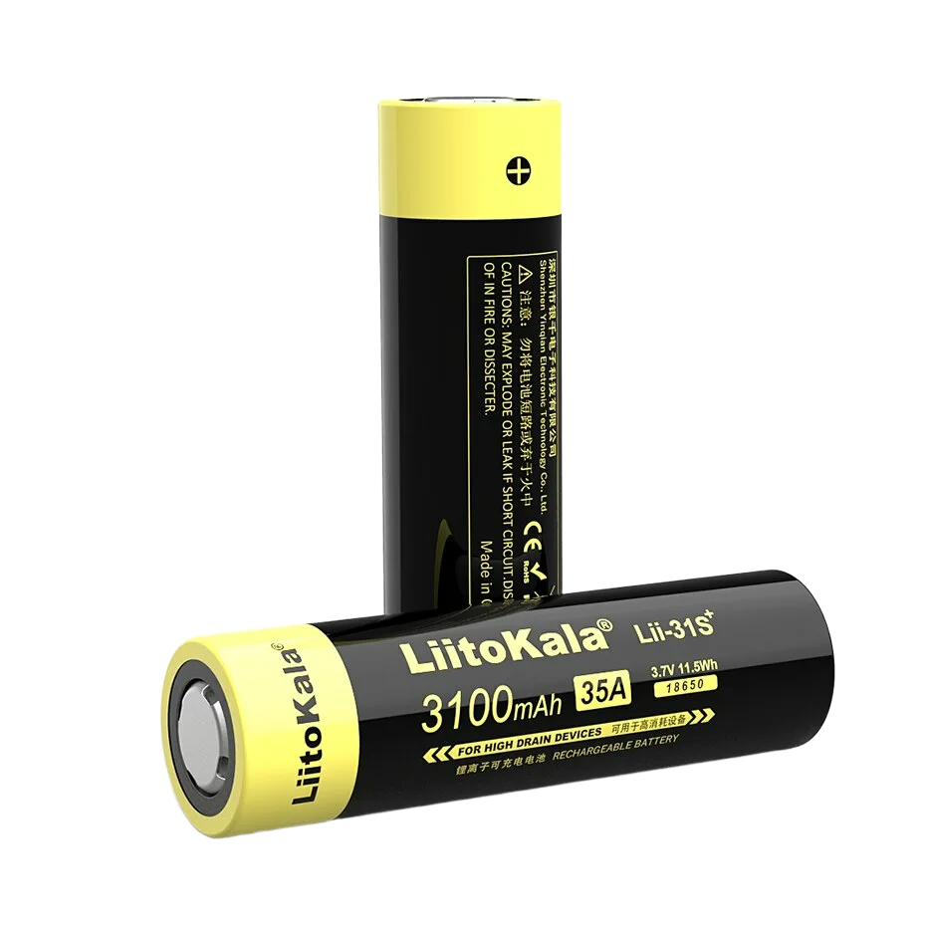
Battery
Battery Features (Li-ion / Li-Po for Robots):
Rechargeable – Can be charged multiple times.
High Energy Density – Stores more energy in a compact size.
Lightweight – Suitable for small robots and drones.
Stable Voltage Output – Provides consistent power to electronics.
Multiple Capacities – Available in different mAh ratings depending on usage.
Low Self-Discharge – Retains charge when not in use.
Protection Circuits – Prevents overcharging, over-discharging, and short circuits.

Slide 15
AURIX is engineered specifically for the Future Engineer category.
thank you for reading :

